Slide 1

First Week Work
ICRL - Muhammad Faizan Asim

Slide 2
Work Outline
Title: Object Detection Using FastSam and YOLOv5
Subtitle: A Comprehensive Analysis and Training on Custom Datasets
Muhammad Faizan
Till 9 June 24

Slide 3
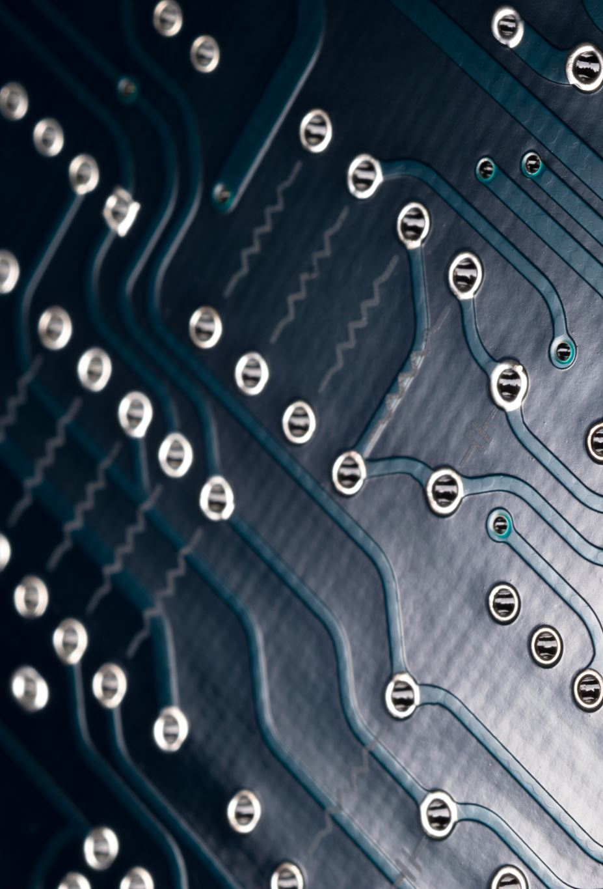
Introduction to FastSam
Overview of FastSam
Key features
Speed
Accuracy
Versatility
Struture base on Yolo V8

Slide 4
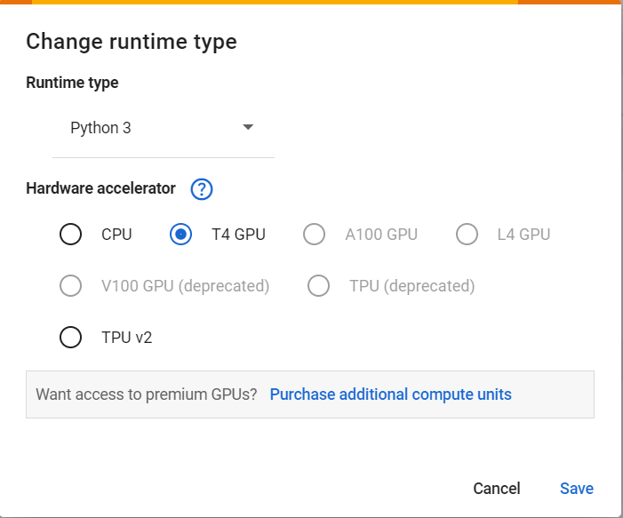
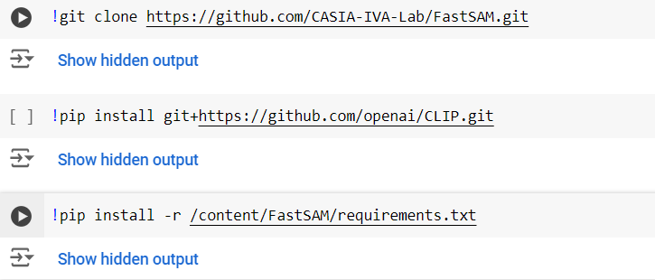
Setting Up FastSam on Google Colab
FastSam on Google Colab
Bullet Points
Step-by-step setup instructions
Installation commands
Configuration and dependencies

Slide 5
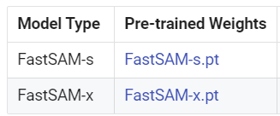
Using Pre-trained Weights of FastSam-x
Pre-trained Weights of FastSam-x Download
Bullet Points
Explanation of FastSam-x pre-trained weights
Code snippet for loading weights
Example images with detection results

Slide 6
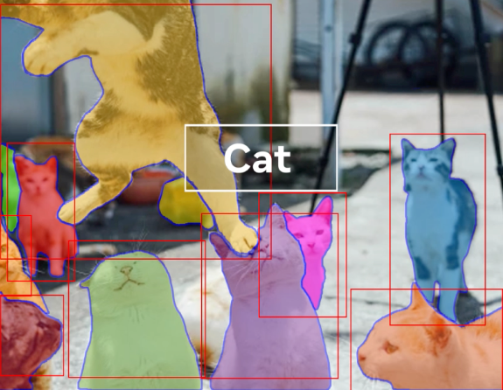
Detecting Dogs and Cats
Dogs and Cats with FastSam-x
Bullet Points
Object detection task overview
Code example for detecting dogs and cats
Detection results
Bounding boxes
Labels on images

Slide 7
Code of Detecting Dogs and Cats

Slide 8
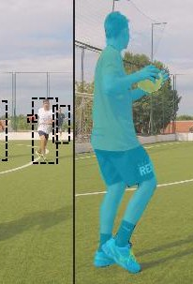
Custom Training on Football Dataset
Custom Training on Football Dataset
Bullet Points
Introduction to football dataset from Roboflow
Steps to import and preprocess dataset
Training FastSam on football dataset
Training configuration and parameters

Slide 9
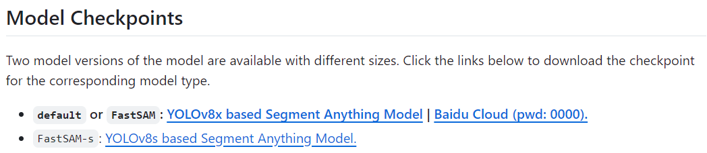
Custom Training on Football Dataset

Slide 10
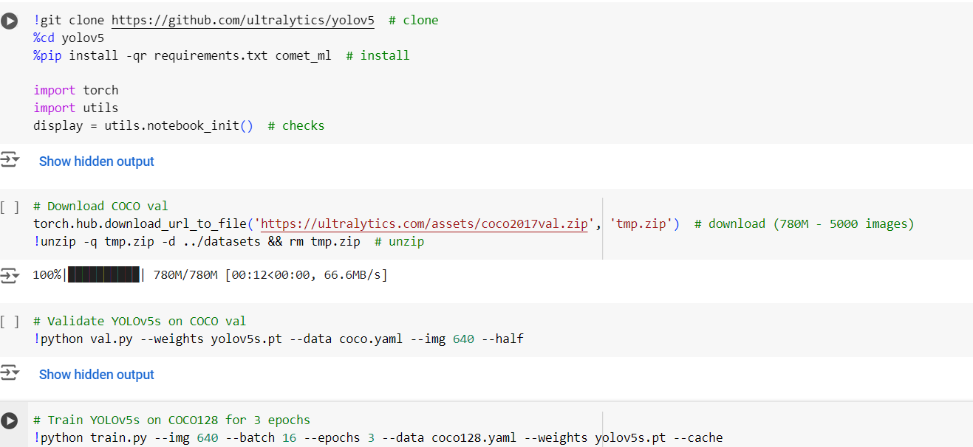
Slide 9: Training YOLOv5 on Custom Dataset
Training YOLOv5 on Custom Dataset
Bullet Points
Overview of YOLOv5
Setup and configuration steps
Training YOLOv5 on custom dataset
Training results and performance metrics

Slide 11
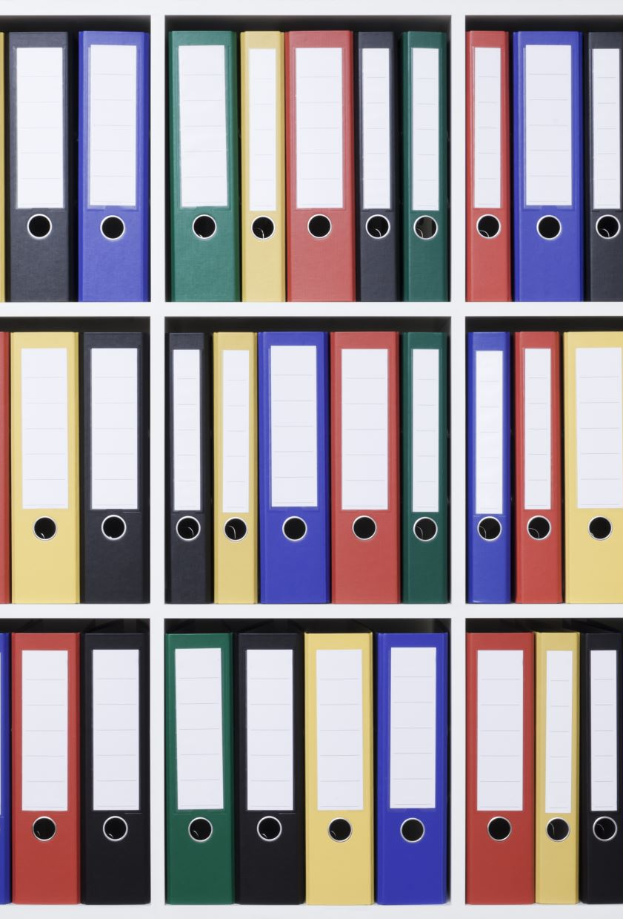
Thanks
References:
Mam Siza Colab Notebook
https://github.com/ultralytics/yolov5
https://docs.ultralytics.com/models/fast-sam/
https://github.com/orgs/ultralytics/discussions/3417
https://universe.roboflow.com/

